Slide 1
Calculator
Group 10
Lv Ruike, Liu Chenxu
Tao Yi, Wang Wenhui

Slide 2

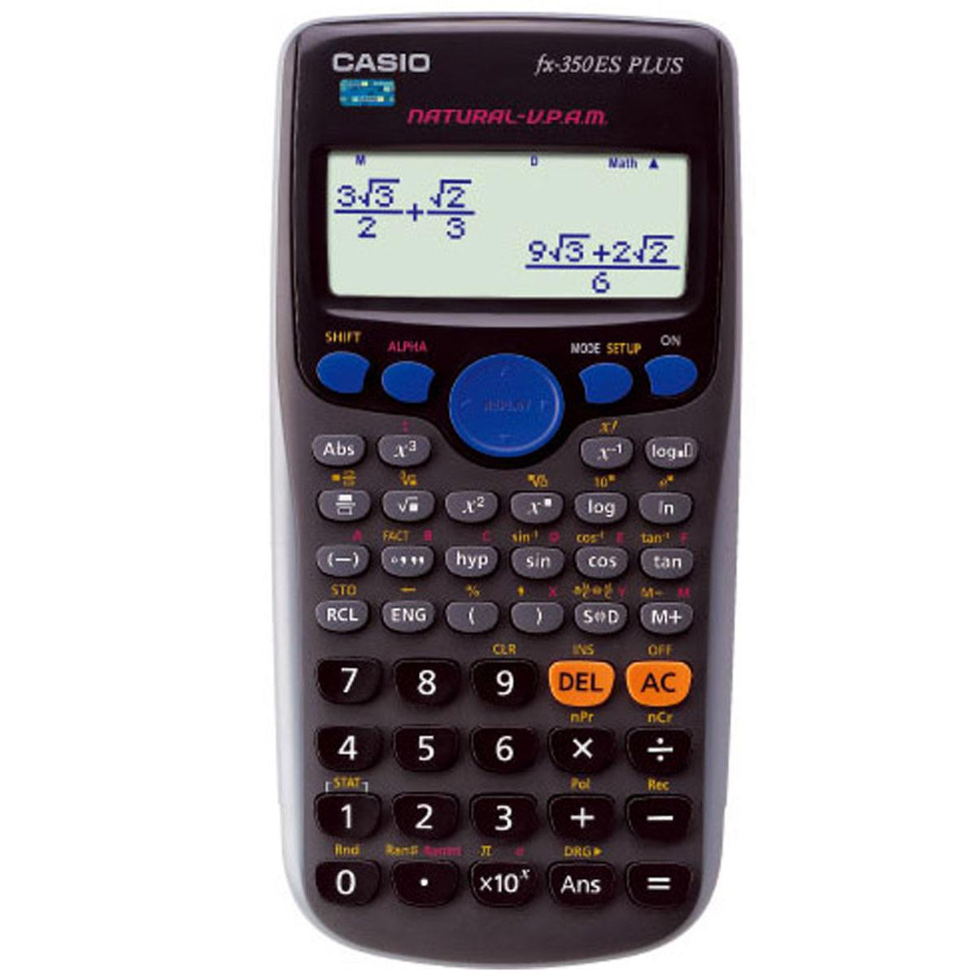
Free!!!
X

Slide 3
Contents
General Design
Function
Innovation Points
Code
Key Benefits

Slide 4

General Design
Based on the stack and queue
Set up stacks
Combine and debug
Add functions

Slide 5

Function
plus, subtract, multiply, divide and other basic operation.
Conversion of number systems
Prime factorizations and find the greatest common divisor and the lowest common multiple.
calculate sinx, cosx, lnx
We can
And based on these functions ,we make a game about figure.

Slide 6
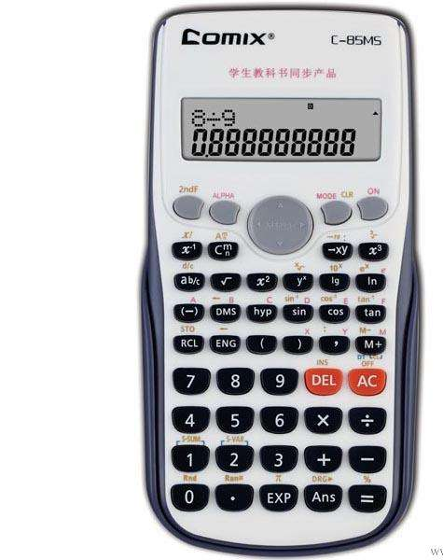
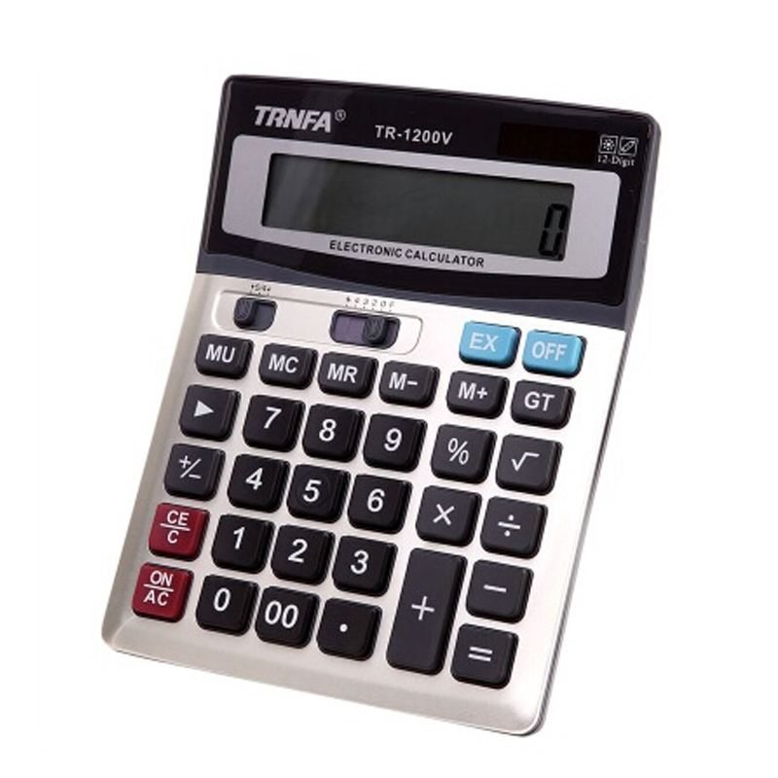
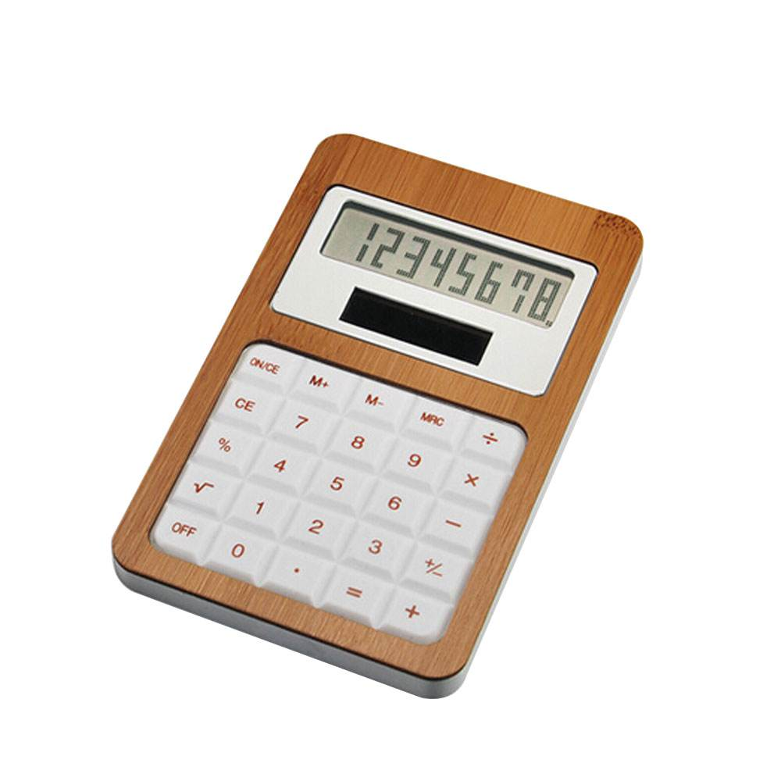
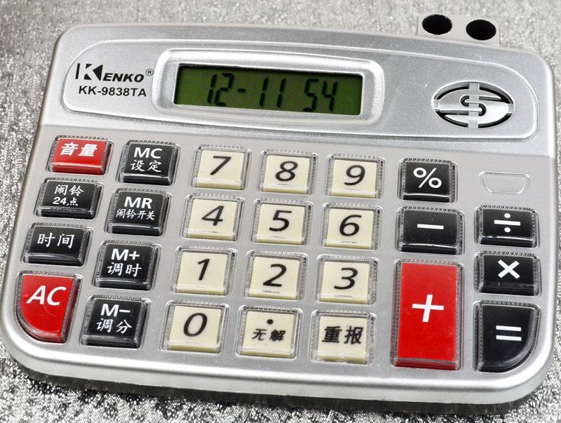
Innovation Points
No Games!

Slide 7

Innovation Points
But we have---
Twenty Four
Points

Slide 8
Innovation Points
Conversion
of
number
systems
Method?
Directly!

Slide 9

Innovation Points
Find the greatest common divisor and the lowest common multiple
find decomposition factor
But we can---

Slide 10
Design for calculator
Code
The main part in our group project
First, we need input a string
Second ,computer will find how many variates are in these string
Then we need assign for each variates
Last one ,we need calculate the results.

Slide 11
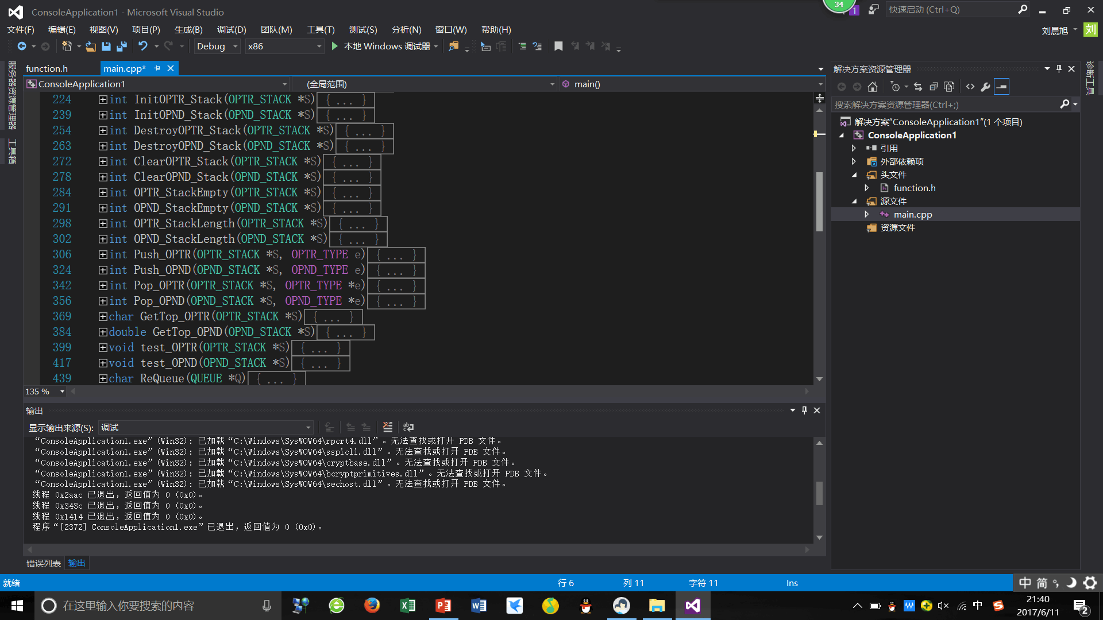
Code for operate the stack
Set up two stacks
destroy two stacks
clear two stacks
Judge if the stack is empty
Get the stacklength
Push stacks
Pop stacks
Get the top

Slide 12
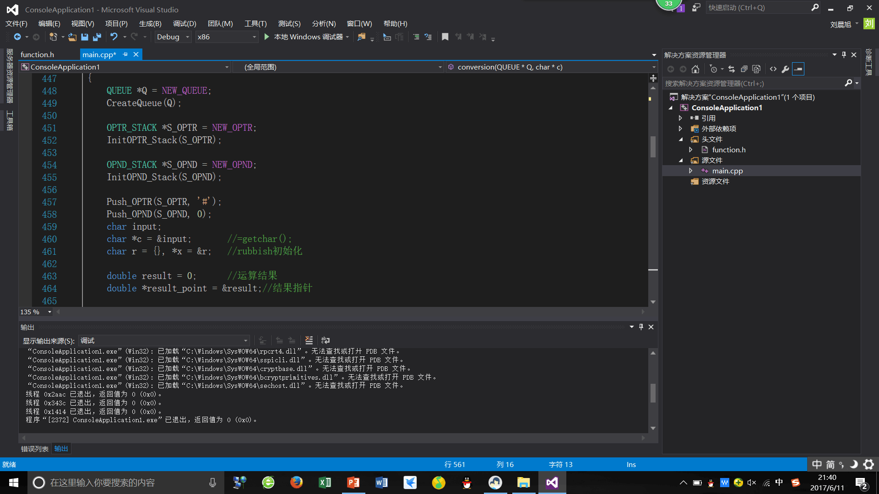
Code for perpare
Prepare two symbol for the bottom of this Stack for judge the last calculation and stop calculation，print the result

Slide 13
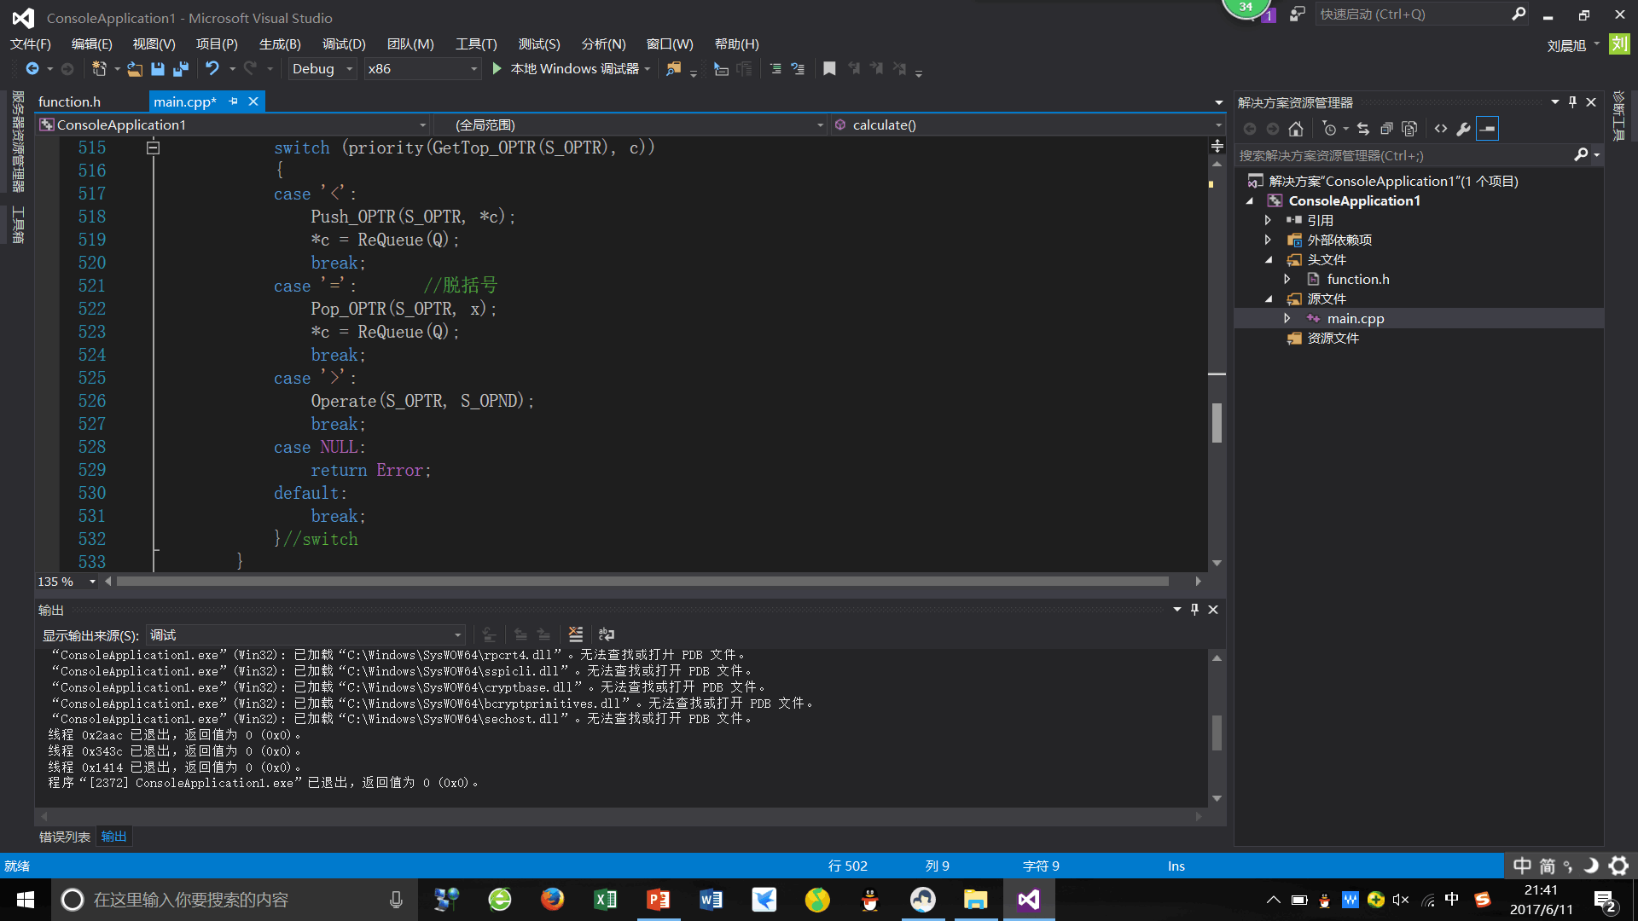
Code for judge the priority
We have the function to judge the priority, and we use it to know which operation should do.

Slide 14
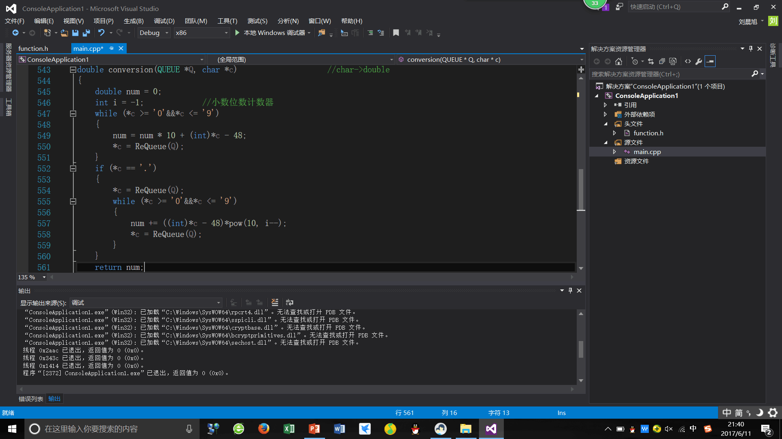
Code for change the form
Meet the number change its form and store into the queue
Meet the’.’

Slide 15
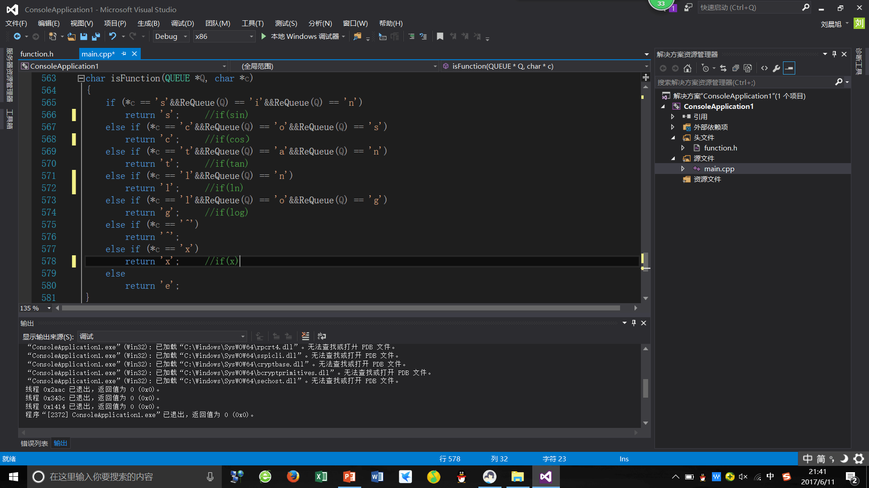
Code for operate the function
We make all of functions in math as an operator so we only operate these operators.

Slide 16
Code
For example
Calculate the result of sinx + cosx +3*x +lnx + tanx when x=2
judge the situation in the stack, if it is not empty, the computer should compare priority
Stack of numbers
Stack of operators
when read +, it has lower precedence compared with * which is the top of the stack, so calculate the results of 2*3 into the stack and then determined whether the + can enter the stack, you need to judge the bottom of the symbol stack
Continue to read *, it has higher precedence when compared with +, so it can directly enter the stack.
2
cos2
tan2
3
6
ln2
*
sin2+cos2+6+ ln2+tan2
sin2
sin2+cos2
sin2+cos2+6+ln2
sin2+cos2+6
+
+
+
+

Slide 17
Compliling Results

Slide 18
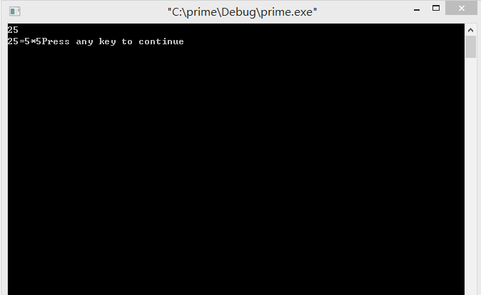

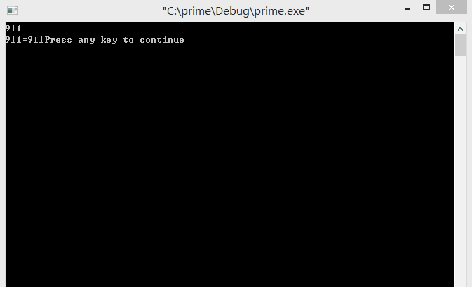


Results

Slide 19
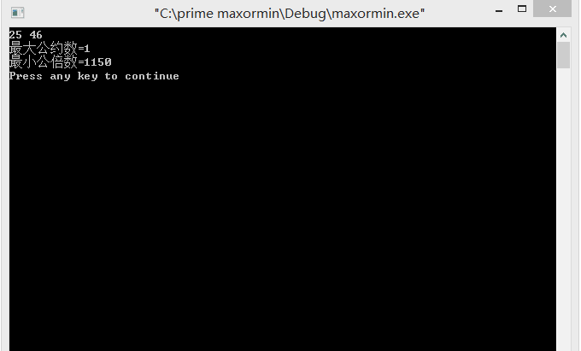


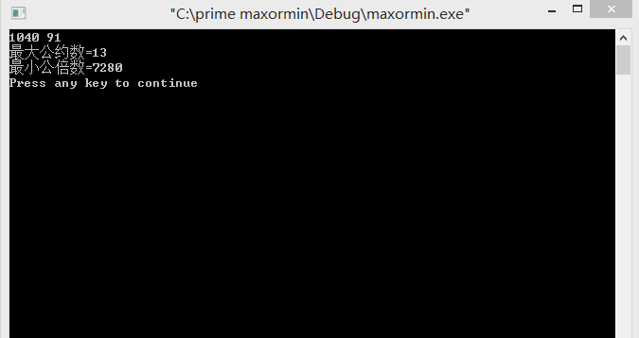
Results

Slide 20
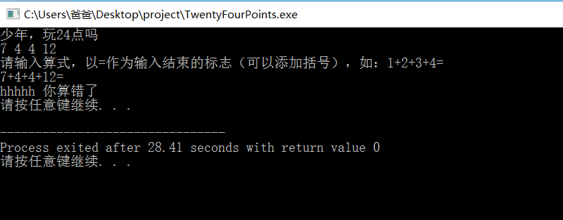
Results

Slide 21
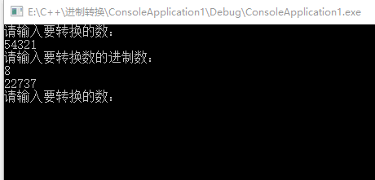
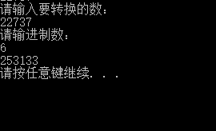
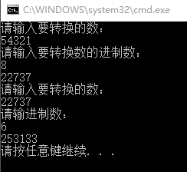

Results:

Slide 22
Key Benefits

Slide 23
Contribution
Liu Chenxu
Group leader
Main tasks and responsibilities
Tao Yi
Twenty-four points
Part of the PPT
Lv Ruike
Prime factorization
Part of the PPT
Wang Wenhui
Part of the PPT
Conversion of number systems

Slide 24

Thanks!

